Slide 1
Topic:
Pipelining

Slide 2
A Pipelining is a series of stages, where some work is done at each stage in parallel.
The stages are connected one to the next to form a pipe - instructions enter at one end, progress through the stages, and exit at the other end.

Slide 3
Definition:
Pipelining is an speed up technique where multiple instructions are overlapped in execution on a processor.

Slide 4
Pipelining: Processors
Computers, like laundry, typically perform the exact same
steps for every instruction:
Fetch an instruction from memory
Decode the instruction
Execute the instruction
Read memory to get input
Write the result back to memory

Slide 5
Instruction Pipeline
Instruction execution process lends itself naturally to pipelining
– overlap the subtasks of instruction fetch, decode and execute
Instruction pipeline has six operations,
Fetch instruction (FI)
Decode instruction and calculate effective address (DA)
Fetch operands (FO)
Execute instructions (EX)
Overlap these operations
CS211 8

Slide 6
Instructions Fetch
The IF stage is responsible for obtaining the requested instruction from memory. The instruction and the program counter are stored in the register as temporary storage.
CS211 9

Slide 7
Decode Instruction
The DA stage is responsible for decoding the instruction and sending out the various control lines to the other parts of the processor. It also calculates the effective address.
CS211 10

Slide 8
Fetch Operands and Execute Instruction
The FO and EI stages are responsible for storing and loading values to and from memory. They also responsible for input and output from the processor respectively. EI stage also writes the result of a calculation, memory access or input into the register file.
CS211 12

Slide 9
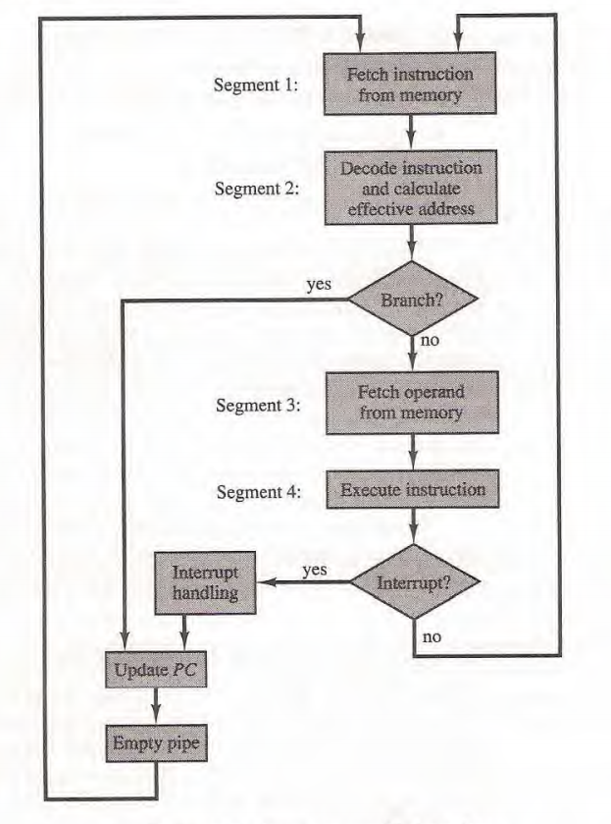
Four Stage Instruction Pipeline

Slide 10
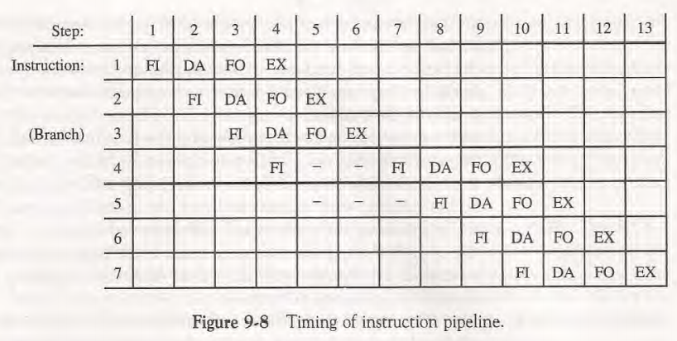
Timing Diagram for Instruction Pipeline Operation

Slide 11
Advantages
Pipelining makes efficient use of resources.
Quicker time of execution of large number of instructions
The parallelism is invisible to the programmer.
https://youtu.be/YhGv5AOcz1s

Slide 12
Thank You!!!

